Slide 1

BERT for ICD code assignment on MIMIC III
By Yuanning Zhen, Chao Pu, George Zhou, Sichao Jia

Slide 2
Introduction
Electronic health records, such as those from the Medical Information Mart for Intensive Care (MIMIC) III database, employ the International Classification of Diseases (ICD) codes to dictate diagnoses and procedures during patient encounters.
The MIMIC III database contains hospital notes on about 40,000 de-identified patients. To annotate all notes would be very time-consuming
Solution:
A machine learning model that can classify phrases as ICD codes automatically

Slide 3
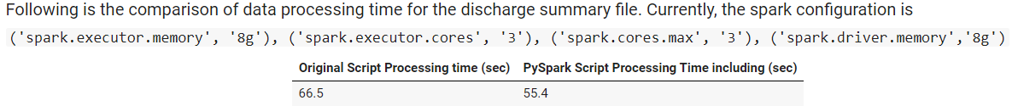
Preprocessing
Processed MIMIC III notes using ICD-9 codes similar to how was done in “ Explainable Prediction of Medical Codes from Clinical text” (1)
Removed tokens with no alphabetic characters, lowercasing tokens, replacing tokens with ‘UNK’
Major difference is in the usage of pyspark
Noticeable processing speedup
https://arxiv.org/pdf/1802.05695.pdf

Slide 4
Preprocessing - Data
Datasets included 8,921 unique ICD-9 codes of which 6,918 are diagnoses codes and 2,003 are procedure codes
When training to account for all codes, we used about 47000, 1600, and about 3000 discharge summaries (notes) for training, validation, and testing respectively.
Training Notes have about:
Average sequence length of 1484
Max sequence length of 10500
Median sequence length of 1341
, where sequence length represents tokens differentiated by strictly white spaces

Slide 5



Tools Used
Pyspark for data processing
Pytorch for model training/tuning
Google Cloud for computational resources

Slide 6
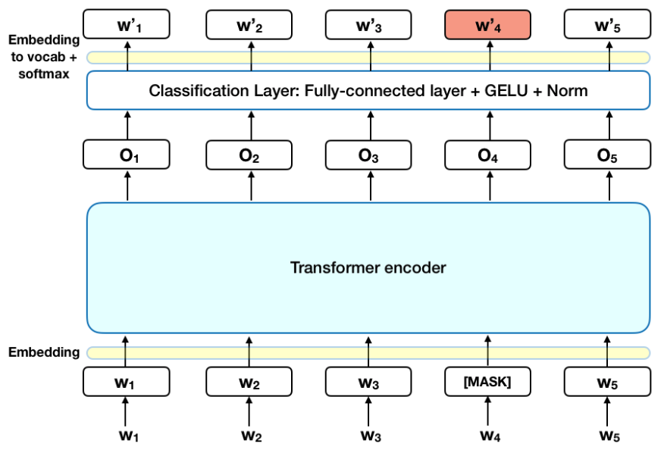
Our Solution - BERT model
A Bidirectional Encoder Representations from Transformers (BERT) model trained on MIMIC III notes(Medical Information Mart for Intensive Care III)
“BERT is the first deeply bidirectional, unsupervised language representation, pre-trained using only a plain text corpus”(1)
https://en.wikipedia.org/wiki/BERT_(language_model)

Slide 7
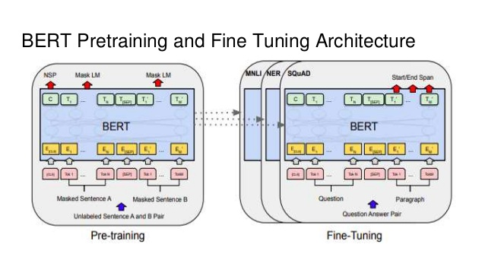
Our Solution - ClinicalBert for ICD Code Assignment
We repurposed the pytorch pre-trained model from “Publicly Available Clinical BERT Embeddings” (1) and fine-tuned it to assign ICD codes automatically.
Pre-training was done similarly to classical BERT model via Masked Language Modeling and Next Sentence Prediction.
https://www.aclweb.org/anthology/W19-1909.pdf & https://github.com/EmilyAlsentzer/clinicalBERT

Slide 8
Model Comparisons
We ran our BERT model and compare results with similar models analyzed in the paper “Explainable Prediction of Medical Codes from Clinical Text” (1):
Single-layer one-dimensional convolutional neural network
Bidirectional gated recurrent unit (Bi-GRU)
Convolutional Attention for Multi-Label Classification(CAML)
Description-Regularized CAML (DR-CAML)
https://arxiv.org/pdf/1802.05695.pdf

Slide 9
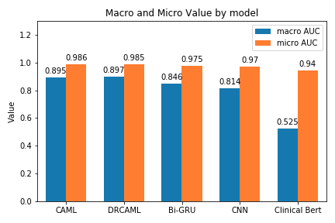
Results
Clinical BERT performs on-par with other models for micro AUC, and worse for macro AUC.
However, macro is not typically used in multi-label classification. Macro highlights performance on rarer codes more so than micro.

Slide 10
Results
Top 50 codes - Test set
 | accuracy |  | precision |  | recall |  | F-score |  | AUC |  | P@5
 | macro | micro | macro | micro | macro | micro | macro | micro | macro | micro | -
CAML | 0.393 | 0.443 | 0.604 | 0.714 | 0.480 | 0.538 | 0.535 | 0.614 | 0.877 | 0.910 | 0.611
DR-CAML | 0.368 | 0.423 | 0.578 | 0.716 | 0.446 | 0.509 | 0.503 | 0.598 | 0.862 | 0.905 | 0.599
CNN | 0.430 | 0.461 | 0.520 | 0.565 | 0.670 | 0.713 | 0.586 | 0.631 | 0.879 | 0.909 | 0.617
Clinical Bert | 0.145 | 0.214 | 0.416 | 0.727 | 0.165 | 0.233 | 0.236 | 0.353 | 0.782 | 0.828 | 0.471
Full dataset - Test set
 | accuracy |  | precision |  | recall |  | F-score |  | AUC |  | P@n
 | macro | micro | macro | micro | macro | micro | macro | micro | macro | micro | 8 | 15
CAML | 0.061 | 0.369 | 0.091 | 0.607 | 0.086 | 0.484 | 0.088 | 0.539 | 0.895 | 0.986 | 0.709 | 0.561
DR-CAML | 0.059 | 0.360 | 0.085 | 0.553 | 0.088 | 0.508 | 0.086 | 0.529 | 0.897 | 0.985 | 0.698 | 0.546
Bi-GRU | 0.028 | 0.279 | 0.057 | 0.584 | 0.038 | 0.349 | 0.045 | 0.436 | 0.846 | 0.975 | 0.619 | 0.469
CNN | 0.024 | 0.271 | 0.049 | 0.550 | 0.035 | 0.348 | 0.040 | 0.426 | 0.814 | 0.970 | 0.594 | 0.454
Clinical Bert | 0.001 | 0.050 | 0.001 | 0.052 | 0.02 | 0.54 | 0.002 | 0.095 | 0.525 | 0.940 | 0.225 | 0.194

Slide 11
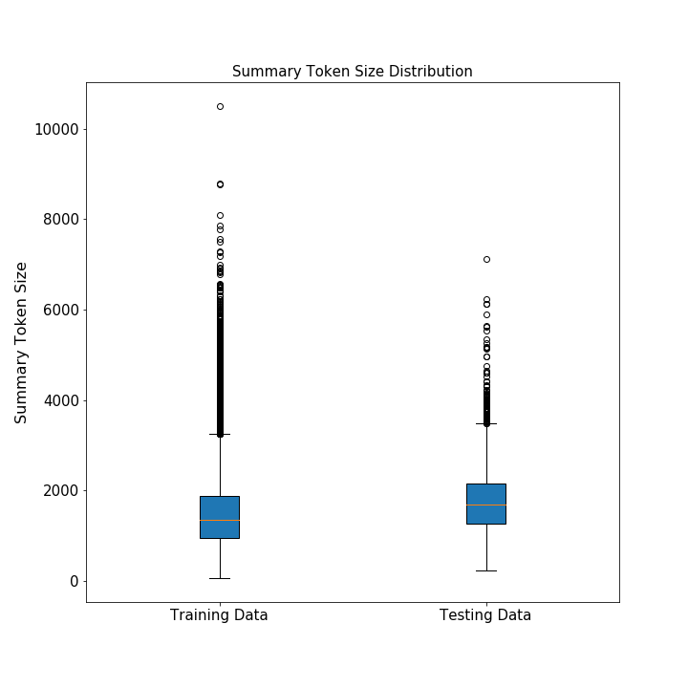
Challenges
Adapting pre-trained BERT to our specific use case
Maximum sequence length of text is 512 for BERT. The mean text length for our notes is about 1400.
Pre-trained BERT was trained on sequence of 128 - may make learning longer lengths difficult

Slide 12
Conclusion and Future Work
Generally, top 50 codes results were better than full codes results - especially true for BERT. BERT still performed worse than CAML and baseline models.
Results could improve with further preprocessing/cleaning of notes
Truncating sequence lengths to 512 or less using domain knowledge
Split longer sequence lengths to lengths of 512 with boundary words duplicated at the splits(1)
https://github.com/google-research/bert/issues/27

Slide 13
Our Solution - Model Methodology
Pre-training done using batch size of 32, a maximum sequence length of 128, and a learning rate of 5 · 10−5 for pre-training our models. Models were trained for 150,000 steps (1).
Fine-tuning for Multi-Class classification done using batch size between 10 and 32, maximum sequence length of 512, and learning rate between 2e-5 and 5e-5 - a dynamically changing learning rate using CylicLR (2). Models were trained for about 4 to 10 epochs.
https://www.aclweb.org/anthology/W19-1909.pdf
https://github.com/bckenstler/CLR

Slide 14
Our Solution - Model Methodology
Metrics
Macro and Micro Precision, F1, and Recall. Primary metric is Precision of top n most common ICD codes - examines how many of top codes are “relevant” - “This is motivated by the potential use case as a decision support application, in which a user is presented with a fixed number of predicted codes to review.”(1)
Tokenized using BERT Tokenizer - WordPiece Tokenization
Training
Trained on about 47,000 notes for however many epoch until dev loss starts plateauing or decreasing
Attempted 4 epochs and 10 epochs
https://arxiv.org/pdf/1802.05695.pdf

Slide 15
Results
CBOW - original -Top 50 codes - Test set
 | accuracy |  | precision |  | recall |  | F-score |  | AUC |  | P@5
 | macro | micro | macro | micro | macro | micro | macro | micro | macro | micro | -
CAML | 0.393 | 0.443 | 0.604 | 0.714 | 0.480 | 0.538 | 0.535 | 0.614 | 0.877 | 0.910 | 0.611
DRCAML | 0.368 | 0.423 | 0.578 | 0.716 | 0.446 | 0.509 | 0.503 | 0.598 | 0.862 | 0.905 | 0.599
CNN | 0.430 | 0.461 | 0.520 | 0.565 | 0.670 | 0.713 | 0.586 | 0.631 | 0.879 | 0.909 | 0.617
Clinic Bert | 0.145 | 0.214 | 0.416 | 0.727 | 0.165 | 0.233 | 0.236 | 0.353 | 0.782 | 0.828 | 0.471
CBOW - original - Full dataset - Test set
 | accuracy |  | precision |  | recall |  | F-score |  | AUC |  | P@n
 | macro | micro | macro | micro | macro | micro | macro | micro | macro | micro | 8 | 15
CAML | 0.061 | 0.369 | 0.091 | 0.607 | 0.086 | 0.484 | 0.088 | 0.539 | 0.895 | 0.986 | 0.709 | 0.561
DRCAML | 0.059 | 0.360 | 0.085 | 0.553 | 0.088 | 0.508 | 0.086 | 0.529 | 0.897 | 0.985 | 0.698 | 0.546
Bi-GRU | 0.028 | 0.279 | 0.057 | 0.584 | 0.038 | 0.349 | 0.045 | 0.436 | 0.846 | 0.975 | 0.619 | 0.469
CNN | 0.024 | 0.271 | 0.049 | 0.550 | 0.035 | 0.348 | 0.040 | 0.426 | 0.814 | 0.970 | 0.594 | 0.454
Clinic Bert | 0.001 | 0.050 | 0.001 | 0.052 | 0.02 | 0.54 | 0.002 | 0.095 | 0.525 | 0.940 | 0.225 | 0.194
SKIP-GRAM - Top 50 codes - Test set
 | accuracy |  | precision |  | recall |  | F-score |  | AUC |  | P@5
 | macro | micro | macro | micro | macro | micro | macro | micro | macro | micro | -
CAML | .358 | .390 | .570 | .630 | .453 | .505 | .505 | .561 | .853 | .878 | .554
DRCAML | .368 | .424 | .588 | .717 | .445 | .509 | .507 | .595 | .863 | .904 | .598
SKIP-GRAM - Full dataset - Test set
 | accuracy |  | precision |  | recall |  | F-score |  | AUC |  | P@n
 | macro | micro | macro | micro | macro | micro | macro | micro | macro | micro | 8 | 15
CAML | .046 | .348 | .076 | .637 | .061 | .434 | .068 | .516 | .886 | .984 | .695 | .545
DRCAML | .040 | .340 | .069 | .634 | .052 | .424 | .059 | .508 | .877 | .984 | .684 | .542

